Slide 1
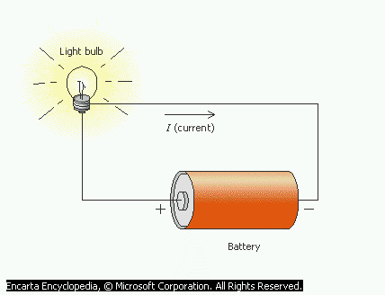
Current Electricity: Digging deeper - Circuit theories & practicalities 2
Current Electricity Lesson 3
Michael Adeleye, Ph.D, P.G. Dip.Ed.

Slide 2
During this lesson we shall:
Book Reference : AQA AS Physics Pages 46-71
Know the rules for series and parallel circuits.
Know the principle behind these rules.
Apply the rules to circuits.
List factors affecting the resistance of a metallic conductor.
Apply Ohm’s law to electric circuits.
Discuss principle of potentiometer as a means of comparing potential differences.

Slide 3
Review of e.m.f and p.d.
Warm-up

Slide 4
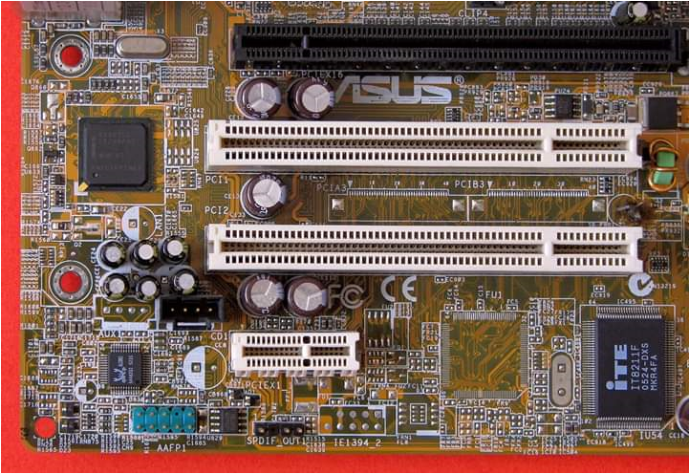
Network analysis and circuit theorems (Kirchhoff’s laws)
Mother board - made up of dozens of various components including silicon chips.

Slide 5
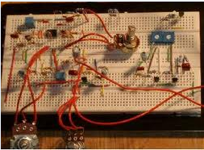
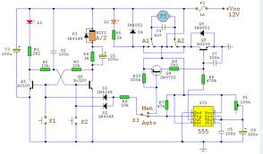
Network analysis and circuit theorems (Kirchhoff’s laws)
Note: Real circuit is a lot more complicated. Typical circuit is made up of dozens of various components.
Circuits Hyperlink

Slide 6
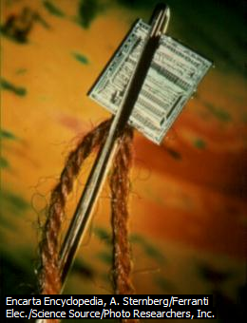
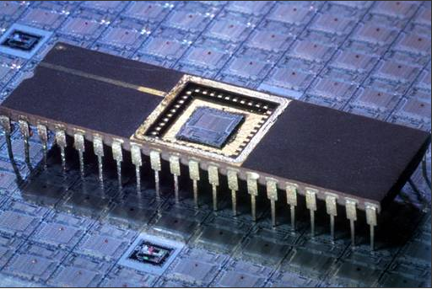
An integrated circuit
The tiny microprocessor shown here is the heart of the personal computer (PC). The IC consists of many circuit elements such as transistors and resistors fabricated on a single piece of silicon or other semiconducting material.
© 1993-2006 Microsoft Corporation.
Notes:
This integrated circuit, an F-100 microprocessor, is only 0.6 cm square and is small enough to pass through the eye of a needle. Microsoft ® Encarta ® 2007. © 1993-2006 Microsoft Corporation. All rights reserved.

Slide 7
KIRCHHOFF’S LAWS
Notes:
Complicated series-parallel circuits may be analyzed by means of two rules called Kirchhoff’s laws. These rules make it possible to find the amount of electric current flowing through each part of any circuit, as well as the voltage across it. - Microsoft ® Encarta ® 2007. © 1993-2006 Microsoft Corporation. All rights reserved.

Slide 8
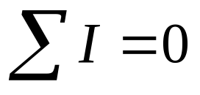
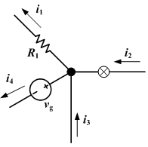
Law 1 – “The algebraic sum of the currents at a junction of an electric circuit is zero.”
Current Rule (Kirchhoff’s 1st Law)
(Junction Rule)
That is the total current entering any junction in a circuit is equal to the current leaving that junction.
i₁ + i₄ = i₂ + i₃
Note: This is a consequence of conservation of charge.
Notes:
At any junction in a circuit, the sum of the currents flowing into a junction is equal to the sum of the currents leaving the same junction.

Slide 9
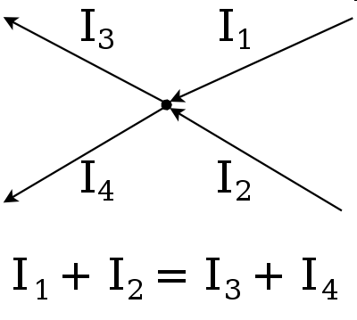
Current Rule (Kirchhoff’s 1st Law)
(Junction Rule)
“At any junction in a circuit, the total current leaving the junction is equal to the total current entering the junction.”

Slide 10
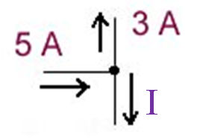
Quick Question 1
What is the missing current I?
I = 2A

Slide 11
Components in Series
The current entering a component is the same as the current leaving it.
→ components do not use up current.
→ they do use up potential (voltage).
The current passing through two or more components in series is the same through each component.
→ the rate of flow of charge through each component is the same at any instant.
Notes:
In the series combination of two or more than two resistances, the current through each resistance is the same.

Slide 12
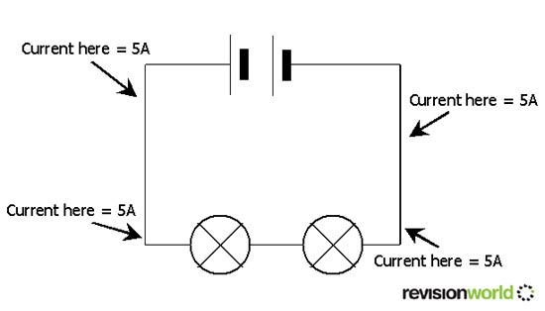
Components in Series

Slide 13
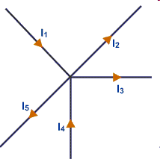
Quick Question 2
If I₁ = 6A, I₂ = 3A, I₃ = 5A, I₄ = 4A, I₅ =?
I₅ = 2A

Slide 14
Re-visiting Potential Difference
The potential difference (pd), or voltage, between any two points in a circuit is defined as the energy transfer per coulomb of charge that flows from one point to the other.

Slide 15
Re-visiting Potential Difference
The charge carriers gain energy when they pass through a cell (a potential rise)
but lose energy when they pass through a component (a potential drop)

Slide 16
  Simulation: conceptual foundation of basic current electricity concepts
  (Demystifying the myth)
Relationships between charges, voltage, current, energy and resistance using virtual physics lab.
Notes:
Once you understand these concepts and the relationships between them, current electricity becomes a minced meat in your hand.

Slide 17
Potential Difference Rule 1
For two or more components in series, the total pd across all the components is equal to the sum of the potential differences across each component.
This is because the pd across each resistor is the energy delivered per coulomb of charge to that resistor.

Slide 18
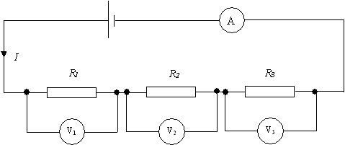
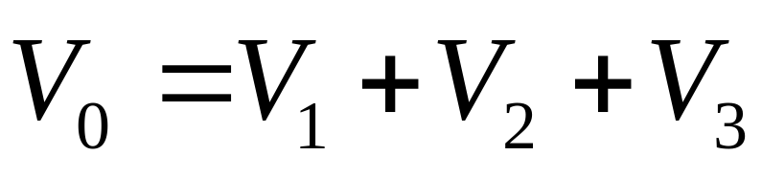
Potential Difference Rule 1
V₀

Slide 19
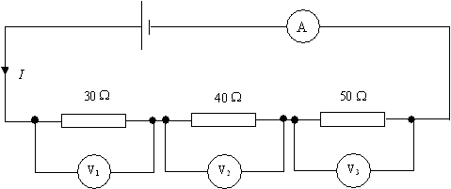
If the current I is 100 mA...
(a) What is 100 mA in amps?
(b) What is the current in each resistor?
(c) What is the voltage across each resistor?
(d) What is the battery voltage?
0.1 A (b) 0.1 A (c) 3V, 4 V & 5 V (d) 12 V

Slide 20
Potential Difference Rule 2
The pd across components in parallel is the same.
In a parallel circuit the charge carriers can pass through any of the components.
The same amount of energy is delivered by a charge carrier regardless of which component it passes through.
Notes:
In the parallel combination of two or more than two resistances, the potential difference across each resistance is the same.

Slide 21
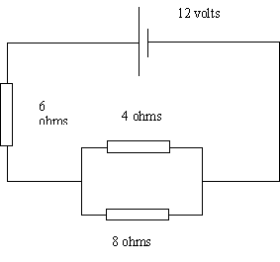
Class Exercise
(a) What is the current in each resistor?
(c) What is the voltage across each resistor?
36/26 A, 24/26 A, 12/26 A
216/26 V (≈8.31 V) & 96/26 V (≈3.69 V)
Notes:
Example of combining resistors in series and parallel.

Slide 22
Potential Difference Rule 3
For any complete loop of a circuit, the sum of the emfs round the loop is equal to the sum of the potential drops round the loop.
This follows from conservation of energy:-
The sum of the emfs → Total electrical energy supplied
The sum of the potential drops → Total energy delivered round the loop

Slide 23
Two key points about a series circuit:
The current throughout the circuit is the same.
The voltages add up to the battery voltage.

Slide 24
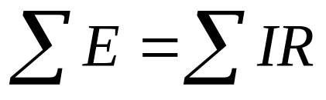
Law 2 – “Around any closed loop in a circuit the algebraic sum of the electromotive forces (e.m.fs) is equal to the algebraic sum of the potential differences (p.ds.)”
Note: This is a consequence of conservation of energy.
P.D. Rule (Kirchhoff’s 2nd Law)
(Loop Rule)
Notes:
Around any closed loop in a circuit, the algebraic sum of the changes in potential must be zero.
If a positive charge is moved from low to high potential region, the electric potential energy increases while it decreases if it moves from high to low pot.

Slide 25
In a circuit, there are sources and sinks of energy.
Some sources of energy (or voltage) include batteries (which convert chemical energy to electrical energy), generators (mechanical to electrical energy), solar cells (radiant to electrical energy), and power supplies and signal generators (electrical to electrical energy).
All other electrical components are sinks of energy.
P.D. Rule (Kirchhoff’s 2nd Law)
(Loop Rule)
Notes:
The simplest circuit will involve one voltage source and one sink, with connecting wires.

Slide 26
Review question
Why are ammeters connected in series and voltmeters connected in parallel?

Slide 27
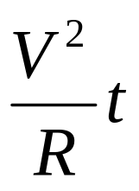
(i) P = IV = I²R = V²/R
(ii) E = IVt = I²Rt =
Electrical Power & Energy

Slide 28
(i) Ohm’s law and
(ii) Kirchhoff’s laws
(iii) P = IV = I²R = V²/R
(iv) E = IVt = I²Rt =
Worked-out examples of circuit problems using:

Slide 29
Further simulations using PheT Java Applets

Slide 30
Further Review Questions
1. Distinguish between e.m.f. and p.d. in terms of energy considerations.
2. Why does the headlight dim if you start a car with the headlights on?
3. Why is Kwh widely used as a practical unit of energy in the home instead of Joules, the S.I. Unit of energy?
4. Describe experiment to determine the resistivity of a
metallic conductor in form of a piece of wire.
Draw relevant circuit diagram.
State measurements to be taken.
Necessary calculations.

Slide 31
Further reading - Optional
Principle of operation of superconductors.

Slide 32
Superconductivity
Normally materials have some resistance.
When current flows through them they heat up.
But superconductors can be cooled below a transition temperature below which the resistivity disappears.
This means no energy is lost as heat energy.
For metals the transition temp is about 10 K
(-263 °C)

Slide 33
Uses of superconductors...
Power cables that can transmit electricity with no loss of energy.
Really strong electromagnets that don’t need a constant power source (e.g. in Maglev trains).
Electronic circuits that work really fast.

Slide 34
Nanotechnology
Miniaturization and recently nanotechnology has made computers and hand held devices/electronic gadgets become increasingly smaller/tinier and hence more mobile while wireless communication has made networking/interconnectivity of these devices easier without cables.

Slide 35
Recap
1. Kirchhoff’s junction rule
At any junction in an electric circuit,
The sum of incoming currents
= The sum of outgoing currents
This implies the conservation of currents.
2. Kirchhoff’s loop rule
In any closed loop of an electric circuit,
The sum of emfs = The sum of voltage drops

Slide 36
Problem solving
Selected problems from CIE past questions
Being able to solve problems is a crucial part of learning Physics, and provides a powerful means for testing understanding the concepts and principles. There are no shortcuts!

Slide 37
Extra Drill
Further application of Kirchhoff’s laws in solving assigned problems in hand-out.

